Slide 1
Acid-Base Regulation & Blood Transfusions

Slide 3
Blood Transfusions
Packed red blood cells (RBCs), also known as erythrocytes, can be used to restore blood levels without substantially increasing the client’s overall blood volume.
Whole blood contains white cells, red cells, and platelets suspended in blood plasma. Trauma and surgery causing a significant blood loss are common uses for whole blood.
The liquid portion of blood is known as plasma which is where the platelets and red and white blood cells are suspended as they travel throughout the body.
Platelets, or thrombocytes, stop or prevent bleeding. Platelets are commonly used during organ transplants, cancer treatments, and surgery.

Slide 4
Blood types
A, B, AB, O
Identified by the presence or absence of antigens
  Antigens will cause an immune response if unfamiliar to the body
    This could cause the client immune system to attack the transfused blood
Rh factor
Protein represented by + or –
  If present in blood then +, if absent then -
To prevent reactions:
  Obtain client type and screen
  Crossmatch blood
    Checks client blood with donor blood for reaction
Notes:
Each person has a specific blood type that is inherited based on the blood types of one’s parents. The four basic blood types are A, B, AB, and O.
The various blood types are identified by the presence or absence of antigens, which can cause an immune response if they are unfamiliar to the body. Since a mismatch of antigens can trigger a patient’s immune system to attack transfused blood,
The Rh factor is a protein represented by (+) if it is present in the blood, and (–) if it is absent. Adding the Rh factor to the blood type produces eight distinct blood types: A+, A–, B+, B–, AB+, AB–, O+, O–. It is crucial that blood for transfusions be matched correctly, as receiving incompatible blood can cause serious injury resulting from an immune reaction.
Safe blood transfusions depend on careful blood typing and cross-matching.
Prior to receiving a blood transfusion, a client must be typed and crossmatched to ensure that the donated blood is compatible.
The laboratory test involves drawing a blood specimen from the client and determining the ABO type of the blood and the Rh factor. If the transfusion will contain RBCs (whole blood or PRBCs), the client’s blood must then be crossmatched with the donor blood to determine if minor antigens are present that may cause incompatibility and a transfusion reaction.
Plasma or serum from the recipient is mixed with blood from the donor. If agglutination of the mixed sample occurs, the blood is incompatible.

Slide 5
Universal donors and recipients
Universal donor blood type:
O-
Universal recipient type:
AB+

Slide 6
Before a blood transfusion
Signed blood consent
Pre-infusion vital signs
Blood remains stored until ready to be transfused
IV size
  Ideally 18-20
Two nurse check before beginning transfusion
Only infuse with normal saline
RN stays with client for first 15 minutes of transfusion
  This is the most common time for a reaction to occur
Vital signs taken 15 minutes after initiation of infusion and then minimum of hourly (hourly may change dependent on facility policy)
Blood transfusion needs to be completed within 4 hours of leaving blood bank

Slide 7
Transfusion Reactions
If reaction suspected…stop the transfusion and assess
Send blood bag and all tubing to blood bank
Remain with client
  Monitor vitals and any symptoms
Acute Hemolytic Reaction
  Caused by incompatible blood
  Reactions range from mild to anaphylactic
Notes:
It is critical to recognize when a transfusion reaction is occurring, as prompt clinical management can prevent serious injury to a client. If a reaction is suspected, the priority is to stop the transfusion while keeping IV access open using an infusion of 0.9% sodium chloride. In some cases, it is necessary to replace the administration set because a significant amount of blood may still be present within the tubing. The blood unit label and client identification should be compared again to verify the blood product was administered to the correct client. The blood unit should be returned to the blood bank with a sample of blood from the client for investigation of the reaction. The nurse should remain with the client, continue to monitor the client’s status, support respirations if needed, and notify the provider.
Transfusion reactions can be acute, occurring with 24 hours of the transfusion, often while the blood is transfusing. Manifestations may vary depending on the cause, but include the following:
Fever
Chills
Altered blood pressure (elevated or decreased)
Respiratory difficulty (wheezing, coughing, dyspnea)
Pain in the chest, abdomen, low back, or flank
Nausea and/or vomiting
Skin manifestations including pruritus, urticaria, flushing, edema (localized), and rash
Jaundice
Urinary changes including oliguria, anuria, and hematuria
The most common acute transfusion reactions include acute hemolytic reactions, which occur when the blood transfused is not compatible with the blood of the client; febrile non-hemolytic transfusion reactions; allergic reactions, which can range from mild to anaphylactic; transfusion-related acute lung injury (TRALI), which results in edema of the lung tissues and airways; and transfusion-associated circulatory overload (TACO), which is often the result of too-rapid administration of blood products.

Slide 8

Acid-Base Balance
Is the correct balance of acidic and basic (alkaline) compounds in the blood.
Acidosis occurs when the levels of acid in the blood are too high.
Alkalosis occurs when the blood becomes too alkaline.
Notes:
To understand acid–base balance, it is important to first have a basic knowledge of pH, which is a reflection of the degree of acidity or alkalinity of a substance determined by the hydrogen ion (H⁺) concentration. On the pH scale, which ranges from 0 (strongly acidic) to 14 (strongly alkaline), 7 is considered neutral. pH concentrations that are less than 7 are considered acidic, while those that are higher than 7 are considered alkaline. The expected reference range for the pH of human blood is quite narrow, 7.35 to 7.45.
The body maintains the blood’s pH in this narrow window through the use of buffers and respiratory and renal regulation, which prevent the blood from becoming too acidic or alkaline. A buffer is a substance that has the chemical ability to absorb changes in pH when an acid or base is added to the solution. The lungs utilize carbonic acid, which is created when carbon dioxide (CO₂) mixes with water, which is slightly acidic, while the kidneys utilize bicarbonate (HCO₃–), which is slightly alkaline, to maintain the appropriate acid–base balance.

Slide 9
Drawing an ABG
Who draws the ABG:
  Respiratory therapy
  Trained nurse
  Varies by hospital and unit
Before the draw:
  Allen test
  Document any supplemental oxygen use
  Position comfortably
  Explain procedure
After the draw:
  Apply pressure to site
    At least 5 min
    May be longer if on anticoagulants
  Assess for hematoma or bleeding
  Montor hand
    Color
    Warmth
    Sensation
Trending ABG results may be beneficial in the care of the client

Slide 10
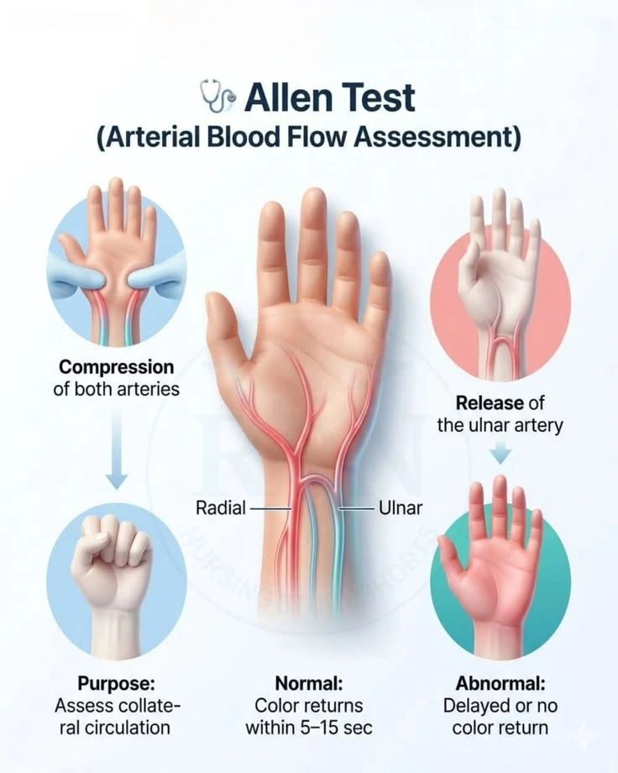


Slide 11
Interpreting ABGs
Before you can interpret you have to know the normal range
  pH
    7.35 to 7.45
    If the pH is less than 7.35 then the pH is acidotic
    If the pH is more than 7.45 then the pH is alkalotic
  HCO3 (bicarbonate or bicarb)
    22 – 26 mEq/L
  PaCO2 (carbon dioxide- sometimes just listed as CO2)
    35 – 45 mm Hg

Slide 12
Interpreting ABGs
Look at the pH
  Is it low or high?
  Remember low = acidotic and high = alkalotic
Next figure out who is to blame…respiratory or metabolic
We can use the ROME method to go to the next step

Slide 13
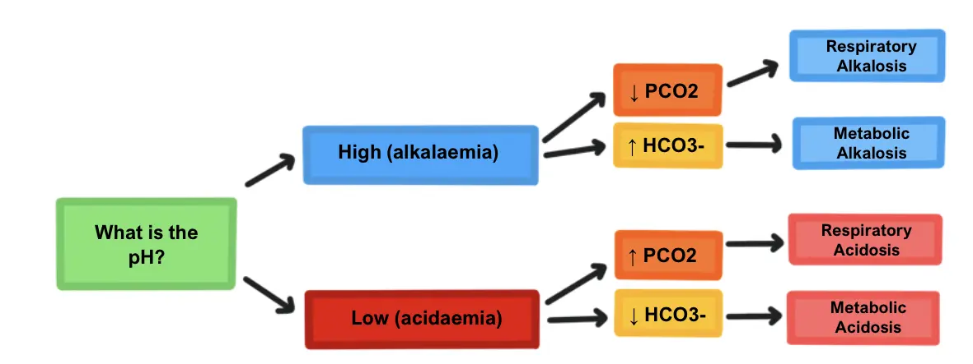

Slide 14
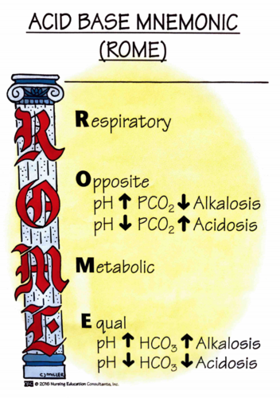

Slide 15
Practice
pH= 7.50 CO2= 30 HCO₃= 25
pH = 7.24 CO2 = 38 HCO₃ = 18

Slide 16
Compensation
Body is going to try and compensate to fix the imbalance
Lungs are always first to respond…
  But they are not great at fixing the issue unless it is a respiratory problem
  Lungs control CO2
  If client is alkalotic then the lungs will hold onto CO2
  If client is acidotic then the lungs will blow off CO2
Kidneys are slow to respond but are best at fixing the problem
  Kidneys control H+ and HCO3 (an acid and a base)
  Kidneys will help reabsorb what makes us better and secrete whatever is making us sick
  So if client is alkalotic then kidneys will reabsorb H+ and secrete HCO3
  If client is acidotic then kidney will reabsorb HCO3 and secrete H+
Notes:
When an acid–base imbalance occurs, the body will attempt to regain homeostasis by using the lungs and kidneys to restore balance.
Metabolic acidosis → The kidneys are not able to rid the body of excess acid → The lungs try to exhale the acid (carbon dioxide) by increasing the respiratory rate and depth.
Metabolic alkalosis → The body is holding on to too much bicarbonate → The lungs try to retain acid by slowing the respiratory rate while the kidneys decrease bicarbonate through excretion into the urine.
Respiratory acidosis → The body is retaining too much carbon dioxide, often due to respiratory depression → The kidneys increase the amount of bicarbonate in the body while excreting hydrogen through the urine.
Respiratory alkalosis → Carbon dioxide levels drop due to too much being exhaled, usually due to hyperventilation → The kidneys excrete bicarbonate through the urine while decreasing the amount of new bicarbonate being produced.
It takes the lungs minutes to hours to respond to an acid–base imbalance, while it takes the kidneys hours to days.

Slide 17
So how do we tell if the body is compensating?
Uncompensated
pH is abnormal
Either CO₂ or HCO₃ is abnormal but not both!
Partially compensated
pH is abnormal
CO₂ is abnormal
HCO₃ is abnormal
Compensated
pH is normal
Both or either CO₂ and HCO₃ are abnormal

Slide 18
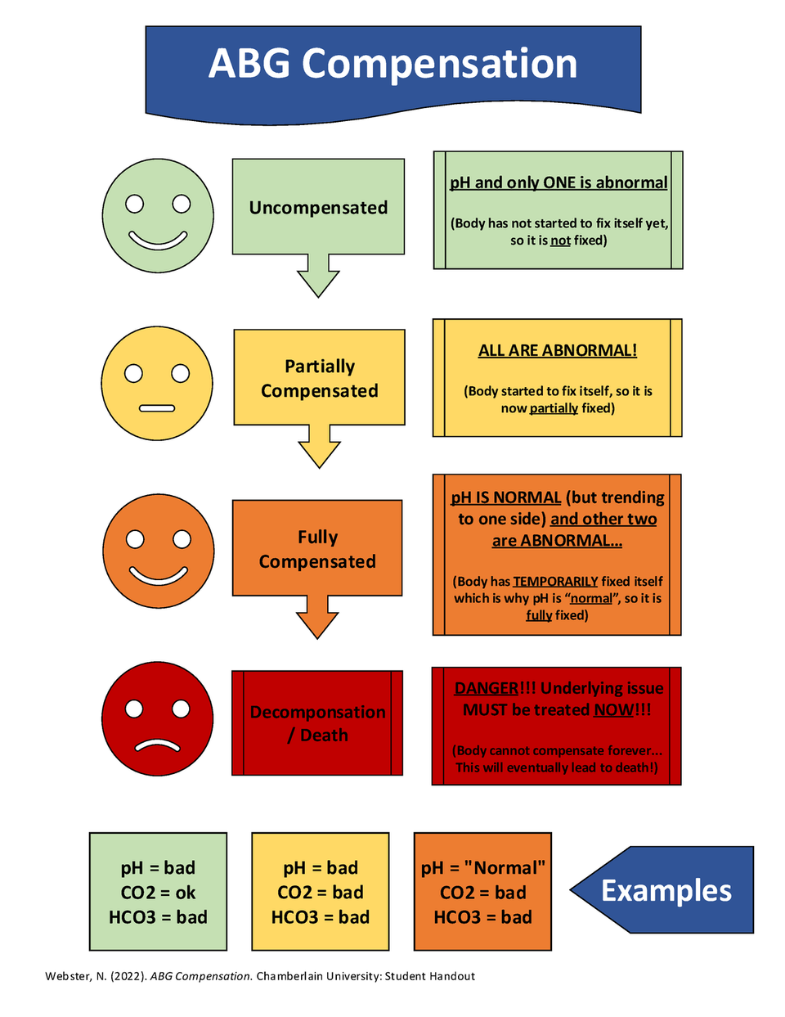

Slide 19
Practice reading
pH 7.38 CO2 = 30 HCO3 = 20
pH 7.50 CO2 = 49 HCO3 = 30
pH 7.31 CO2= 34 HCO3= 21
pH 7.56 CO2 = 20 HCO3= 20
pH 7.43 CO2 = 48 HCO3 = 30

Slide 20
ABG interpretation resources
RESOURCES
https://nurseslabs.com/arterial-blood-gas-abgs-nclex-quiz/
  Two 20 quiz ABG interpretation quizzes with rationales.
https://abg.ninja/abg
  just do not worry about the last compensation box. More advanced than you need to know now.

Slide 21
Respiratory Acidosis
pH < 7.35 | CO2 > 45
Lungs are RETAINING too much CO2
Causes — "DEPRESS" breathing:
  D — Drugs: opioids and sedatives
  E — Edema: fluid in the lungs (pulmonary edema)
  P — Pneumonia: excess mucus and secretions
  R — Respiratory center of brain damaged (stroke, trauma)
  E — Emboli: pulmonary embolism
  S — Spasm of the bronchial (asthma)
  S — Sac elasticity damage: COPD and emphysema
Signs and Symptoms:
  Rapid, shallow respirations
  Low blood pressure
  Pale or cyanotic skin
  Headache and dizziness
  Confusion
  Fatigue
  Anxiety
  Shortness of breath
Notes:
DEPRESS is one of the most reliable mnemonics for respiratory acidosis causes and covers the entire spectrum students will encounter clinically — from medication side effects (opioid-induced respiratory depression is one of the most common and preventable causes) to structural lung disease (COPD, emphysema) to airway obstruction (asthma, pulmonary edema). The unifying mechanism in every case is hypoventilation — the lungs are not moving enough air to blow off CO2, so CO2 accumulates and the blood becomes acidotic. Students should connect this to their opioid safety content: every patient receiving opioids needs respiratory rate monitoring specifically because opioids suppress the respiratory drive and cause CO2 retention.

Slide 22
Treatment and Nursing Care
Treatment:
Goal: improve ventilation and remove excess CO2
  Monitor vital signs and respiratory status
  Administer supplemental oxygen
  Maintain patent airway
  Bronchodilators for bronchospasm or COPD
  CPAP or BiPAP for respiratory support
    If CO2 > 50: may require intubation and mechanical ventilation
  If pneumonia: IV fluids to thin secretions, antibiotics if infection-related
  If opioid-induced: naloxone (Narcan) to reverse respiratory depression
Nursing considerations:
  Position in high Fowler's to maximize lung expansion
  Encourage deep breathing and coughing
  Incentive spirometry every hour while awake
  Caution with oxygen in COPD patients — hypoxic drive; titrate to maintain O2 sat 88-92%
  Assess level of consciousness — worsening confusion = worsening acidosis
  Prepare for intubation if CO2 rising and patient tiring
  If opioid-related: monitor sedation scale, have naloxone at bedside
Notes:
The COPD oxygen caution is one of the most clinically important and most frequently misunderstood points in respiratory acidosis. The hypoxic drive concept: patients with chronic CO2 retention (COPD, emphysema) have chronically elevated CO2 and their respiratory centers become desensitized to it. Their primary stimulus to breathe becomes hypoxia rather than hypercapnia. If a high-flow oxygen mask raises their O2 sat above 92-94%, it removes their drive to breathe, worsening hypoventilation and CO2 retention. The target sat range for COPD patients is 88-92% — counterintuitive but evidence-based. The opioid connection is high-stakes: naloxone reverses respiratory depression rapidly but wears off before the opioid does — patients must be monitored for re-narcotization after naloxone administration.

Slide 23
Respiratory Alkalosis
pH > 7.45 | CO2 < 35 | HCO3 normal (uncompensated)
Lungs are LOSING too much CO2 through hyperventilation
Causes — "TACHypnea":
  T — Temperature elevation (fever drives hyperventilation)
  A — Anxiety and panic attacks
  C — Conditions causing decreased O2 intake (hypoxemia triggers hyperventilation)
  H — Hypoxemia and hyperventilation (mechanical ventilation settings too high)
Additional causes: pain, sepsis, salicylate toxicity (aspirin overdose)
Signs and Symptoms:
  Deep, rapid breathing (hyperventilation)
  Tachycardia
  Light-headedness and dizziness
  Lethargy
  Confusion
  Nausea and vomiting
  Numbness and tingling in extremities and around mouth
  Muscle twitching and tetany (from low ionized calcium)
Notes:
The numbness, tingling, and tetany in respiratory alkalosis are explained by the effect of alkalosis on calcium binding. In an alkalotic environment, calcium binds more tightly to albumin, reducing the amount of free ionized calcium available to nerve cells. This mimics hypocalcemia — even though total calcium is normal — and produces the characteristic perioral tingling and carpopedal spasm. Students who understand this mechanism will connect it to their calcium content and recognize why a hyperventilating patient may have carpopedal spasm without an actual calcium deficiency. Salicylate toxicity (aspirin overdose) is a classic NCLEX cause of respiratory alkalosis — aspirin directly stimulates the respiratory center, causing hyperventilation and CO2 loss. This is worth mentioning because it is counterintuitive that an acid (aspirin) causes alkalosis.

Slide 24
Treatment and Nursing Care
Treatment:
Goal: slow breathing, retain CO2
  Treat the underlying cause — fix the breathing problem
  Anxiety-induced: coaching slow, controlled breathing
  Rebreathing into a paper bag — patient rebreathes exhaled CO2 (controversial, use cautiously)
  Non-rebreather mask to increase inspired CO2 in controlled settings
  Anti-anxiety medications or sedatives if anxiety is cause
  Adjust ventilator settings if mechanical ventilation is blowing off too much CO2
  Treat fever, pain, or hypoxemia if those are the underlying cause
Nursing considerations:
  Keep the client calm — anxiety worsens hyperventilation
  Fall precautions — light-headedness and confusion increase fall risk
  Coach breathing: "breathe in slowly... breathe out slowly" — count with patient
  Assess for tingling — indicates significant alkalosis
  Provide calm, reassuring environment — reduce stimuli
  Monitor oxygen saturation
  Treat pain proactively — uncontrolled pain causes hyperventilation
Notes:
Keeping the patient calm is both a comfort measure and a direct treatment — anxiety causes hyperventilation, hyperventilation causes alkalosis, alkalosis causes tingling and light-headedness, tingling and light-headedness cause more anxiety. Breaking the cycle requires a calm, therapeutic presence. Nurses who can coach breathing effectively are providing real treatment. The paper bag technique is mentioned in many textbooks but has fallen somewhat out of favor because of concern that a patient who is hyperventilating due to hypoxia (not anxiety) could be harmed by rebreathing CO2 that reduces their already-low O2. The nurse must confirm the cause before using this technique. For mechanically ventilated patients, respiratory alkalosis is often a ventilator management issue — the rate or tidal volume is set too high, blowing off too much CO2. The nurse who recognizes an alkalotic pH with low CO2 on a ventilated patient should notify the provider to adjust settings.

Slide 25
Metabolic Acidosis
pH < 7.35 | HCO3 < 22 | CO2 normal (uncompensated)
Kidneys have too little HCO3 and too much H+
Causes — "MUDPILES":
  M — Malnutrition
  U — Uremia (renal failure)
  D — Diabetic ketoacidosis (DKA) — not enough insulin → fat metabolism → excess ketones (acid)
  P — Poisoning
  I — Isoniazid / Iron toxicity
  L — Lactic acidosis (shock, sepsis)
  E — Ethanol (alcoholism)
  S — Severe diarrhea (bicarb comes out of your base — lost in stool)
Signs and Symptoms:
  Kussmaul respirations — deep, rapid breathing (lungs blowing off CO2 to compensate)
  Confusion and lethargy
  Headache
  Warm, flushed skin (vasodilation)
  Nausea and vomiting
  Fruity breath odor (DKA — ketones)
  Decreased level of consciousness in severe cases
  Dysrhythmias
Notes:
MUDPILES covers the major causes of high anion gap metabolic acidosis — a distinction students will encounter when they progress to more advanced practice but don't need to master in fundamentals. The clinically most important causes for fundamentals students are DKA, renal failure, severe diarrhea, and lactic acidosis from shock or sepsis. DKA deserves special attention: without insulin, cells cannot use glucose for energy and switch to burning fat. Fat metabolism produces ketone bodies — organic acids — that drop the pH. The fruity breath odor from ketones is a classic assessment finding. Severe diarrhea causes metabolic acidosis because bicarbonate is secreted into the intestinal tract and lost in the stool — 'bicarb comes out of your base' is a useful way for students to remember it. Kussmaul respirations are the body's compensatory attempt — the lungs try to blow off CO2 to raise the pH. This is appropriate compensation and the rate should not be suppressed.

Slide 26
Treatment and Nursing Care
Treatment:
Identify and treat the underlying cause — treatment varies by etiology
  IV sodium bicarbonate for severe acidosis (pH < 7.1)
  Seizure precautions — acidosis lowers seizure threshold
  Monitor potassium closely — acidosis drives K+ out of cells (hyperkalemia risk)
DKA specific:
  Administer IV regular insulin infusion
  IV fluid resuscitation — patients are severely dehydrated
Renal failure specific:
  Dialysis may be required
Nursing considerations:
Monitor respiratory status — Kussmaul breathing is compensation, do not suppress
Strict intake and output
Continuous cardiac monitoring
Seizure precautions: padded rails, suction and oxygen at bedside
Monitor potassium every 2-4 hours during treatment — K+ drops as acidosis corrects
Assess level of consciousness
Notes:
The potassium relationship in metabolic acidosis is critically important and frequently tested. In acidosis, excess hydrogen ions move into cells and potassium moves out to maintain electrical neutrality — so metabolic acidosis causes hyperkalemia even when total body potassium is normal or low. As the acidosis is corrected with treatment, potassium shifts back into cells and the serum potassium drops, sometimes precipitously. A patient with DKA who looks hyperkalemic at presentation may become severely hypokalemic during insulin treatment — this is why potassium monitoring and replacement during DKA management is essential. The nurse who monitors potassium only at the beginning of treatment will miss this dangerous shift. Kussmaul respirations represent appropriate physiological compensation — suppressing them with sedation or position changes would worsen the acidosis.

Slide 27
Metabolic Alkalosis
pH > 7.45 | HCO3 > 26 | CO2 normal (uncompensated)
Kidneys have too much HCO3 and too little H+
Causes:
  Too many antacids (excess sodium bicarbonate intake — too much BASE)
  Diuretics — loss of acid in urine
  Excess vomiting
  Prolonged NG suction
  Hyperaldosteronism — aldosterone causes H+ excretion and HCO3 retention
  Blood transfusions — citrate in stored blood is metabolized to bicarbonate
Signs and Symptoms:
  Hypoventilation — lungs retaining CO2 to compensate (slow, shallow breathing)
  Muscle twitching and cramping
  Lethargy
  Tingling of fingers and toes (from low ionized calcium — same mechanism as resp alkalosis)
  Light-headedness
  Confusion
  Headache
  Dizziness
  Nausea and vomiting
Notes:
Vomiting and NG suctioning are the most common causes of metabolic alkalosis in hospitalized patients and are worth emphasizing. When stomach acid is lost — whether through vomiting or suction — the body loses H+ ions (acid). Less acid means more alkaline blood. This also explains why patients with bulimia nervosa frequently develop metabolic alkalosis as a chronic condition. The hypokalemia connection is bidirectional and important: diuretics cause both hypokalemia and metabolic alkalosis simultaneously, and hypokalemia independently worsens alkalosis because the kidneys conserve K+ by excreting H+ instead. Students will encounter this combination frequently — a patient on furosemide who develops metabolic alkalosis should prompt immediate potassium assessment. The hypoventilation that serves as compensation is limited because the body will not allow O2 to drop dangerously low just to retain CO2 — so respiratory compensation for metabolic alkalosis is always partial.

Slide 28
Treatment and Nursing Care
Treatment:
Identify and treat the underlying cause
  IV fluids — help kidneys excrete excess bicarbonate
  Replace potassium — hypokalemia is almost always concurrent
  Antiemetics if nausea and vomiting is the cause
  Discontinue or reduce diuretics if medication-induced
  Discontinue unnecessary NG suction or switch to intermittent suction
  Correct concurrent electrolyte imbalances — calcium and magnesium also affected
Nursing considerations:
  Monitor respiratory status — watch for worsening hypoventilation and hypoxia
  Watch for signs of respiratory distress —
  Cardiac monitoring — dysrhythmias from concurrent hypokalemia are common
  Assess for tingling, muscle twitching, and tetany — signs of alkalosis severity
  Strict intake and output
  Fall precautions — light-headedness and confusion increase fall risk
  Educate on avoiding excessive antacid use, especially bicarbonate-containing products
Notes:
The watch for respiratory distress note is important: while hypoventilation is the expected compensation for metabolic alkalosis, the body will not allow it to progress to the point of dangerous hypoxia. If a patient compensating for metabolic alkalosis develops an O2 sat below 88-90%, the respiratory drive will override the compensation and the patient will breathe faster despite the alkalosis. This means compensation is always partial and the metabolic problem must be fixed. Potassium replacement is the single most frequently needed intervention in metabolic alkalosis because the causes (diuretics, vomiting, NG suction) all cause potassium loss simultaneously. The nurse who replaces potassium appropriately is treating both the electrolyte imbalance and contributing to correcting the pH. Calcium monitoring matters because alkalosis, like respiratory alkalosis, reduces ionized calcium and can produce tingling and tetany even with a normal total calcium level.

Slide 29

Questions?

